Slide 1

NH Small MS4 Permit for the
Town of Pelham NH
presented by
GeoInsight, Inc.
186 Granite Street
Manchester NH
603.314.0820
September 14, 2020

Slide 2

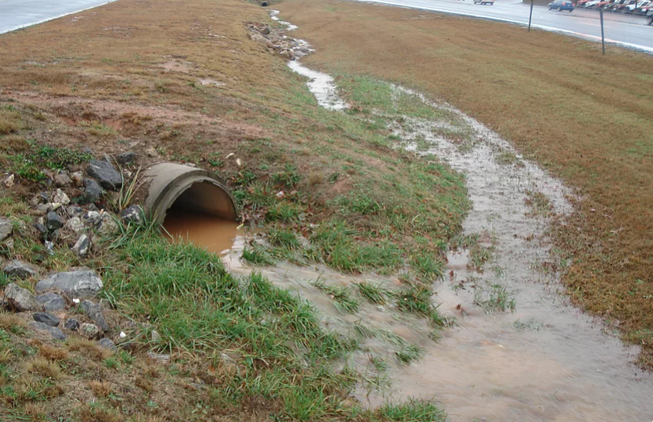
Stormwater Pollution Basics
excess precipitation & snow melt = stormwater runoff
stormwater runoff flows across the land surface
picks up pollutants from the ground
enters storm sewer systems
ultimately flows to receiving waters
https://cityofeasley.wixsite.com/cityofeasley/stormwater

Slide 3

Polluted Stormwater Runoff
Common pollutants in stormwater include:
  oil and grease from road, lots, or municipal yards
  high nutrient fertilizers and pesticides from lawns
  sediment and trash from construction sites
  illicit discharges
  pet wastes
  leaking sewer or septic discharges
  yard wastes
Understanding MS4. Pennsylvania Environmental Council. January 29, 2016.

Slide 4

Water pollution is regulated…
1972 Federal Clean Water Act
regulation of “point source” discharges of pollutants to “Waters of the U.S.”
through EPA National Pollutant Discharge Elimination System Permits (NPDES)
“Stormwater Phase II Rule” establishes MS4 stormwater management program
EPA administers New Hampshire’s State Clean Water Act permit program
American Broadcasting Company.
Schoolhouse Rock! 1976.

Slide 5
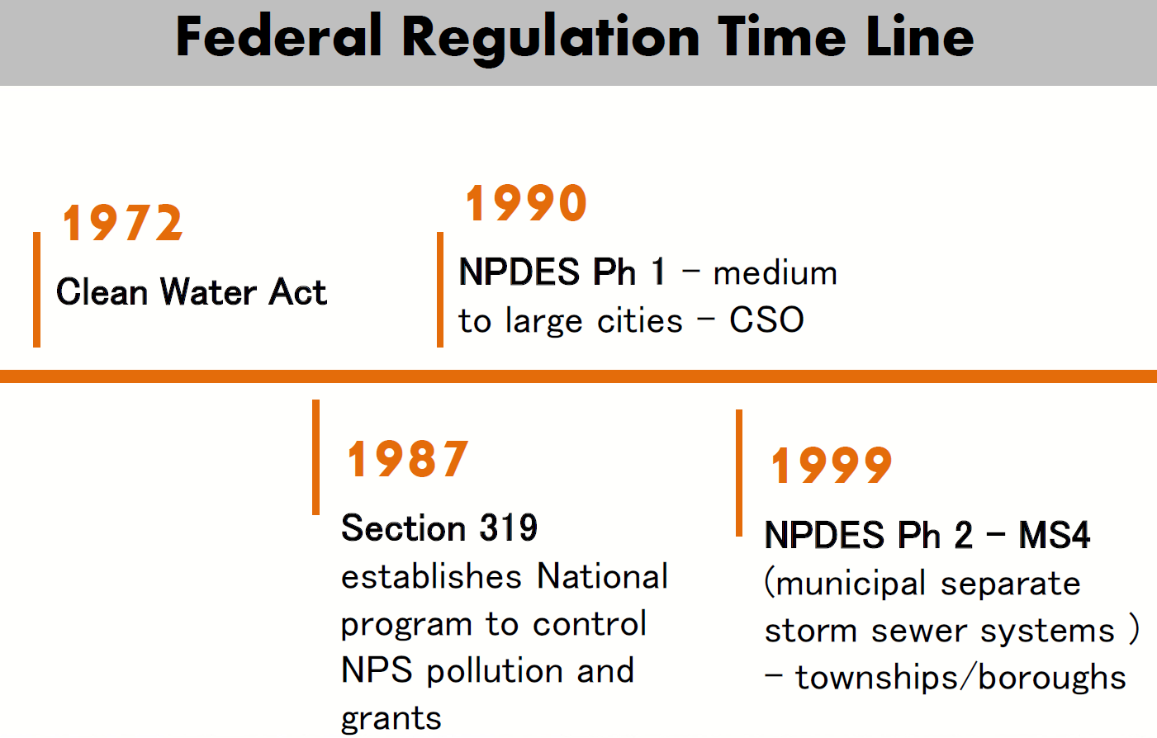
Understanding MS4. Pennsylvania Environmental Council. January 29, 2016.

Slide 6
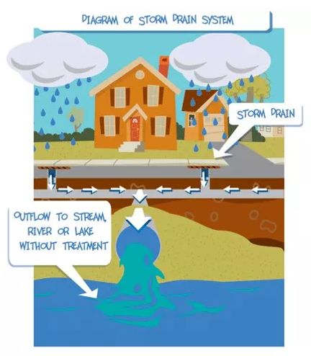
What is the MS4 permit?
Municipal Separate Storm Sewer System
reduce the discharge of pollutants to the “maximum extent practicable” (MEP)
proactively protect water quality
satisfy the water quality requirements of the Clean Water Act (CWA)
https://www.monroecounty.gov/des-stormwater-coalition

Slide 7
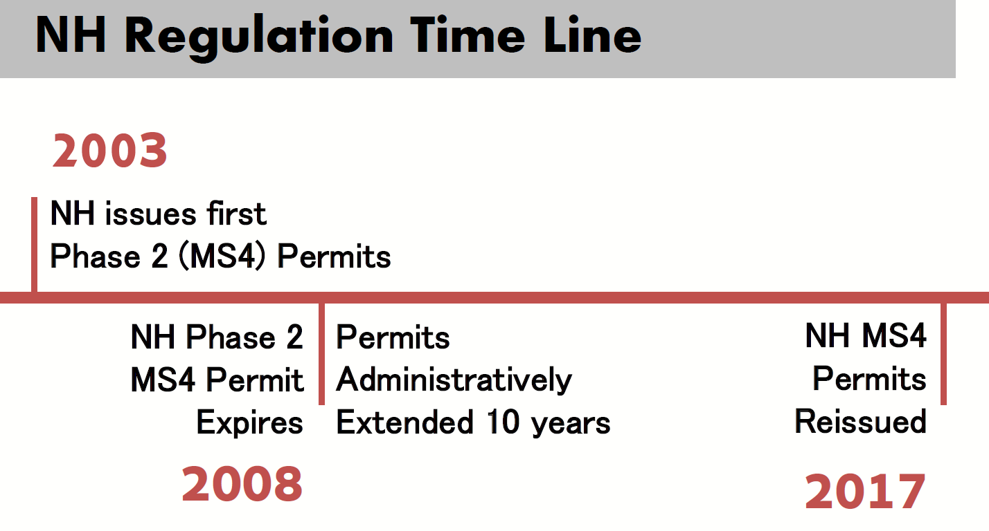
PELHAM COVERAGE AUTHORIZED

Slide 8

2017 MS4 General Permit
So many expanded requirements compared to 2003 Permit:
  local stormwater regulation, enforcement, and record keeping
  formal written SWMP
  formal written IDDE program and mapping
  Town-owned facilities inventories, O&Ms, and SWPPPs
  salt management and reduction plan
  meet water quality standards
  enhanced BMPs for impaired waters
  Most small towns cannot manage all the requirements alone.

Slide 9

ACK-ronyms and other Confusing Terms
CWA Clean Water Act
NPDES National Pollutant Discharge Elimination System
MS4 Municipal Separate Storm Sewer System
UA Urbanized Area (Census Bureau)
BMP Management Plan
MCM Minimum Control Measures
O&M Operations and Maintenance (Plan)
SWPPP Stormwater Pollution Prevention Plan
TMDL Total Maximum Daily Load
Berkeley Breathed,
Bloom County

Slide 10

ACK-ronyms and other Confusing Terms
Point Source: A discrete location where stormwater discharges to the environment and where the source of pollution can be traced and identified.
Non-Point Source: Stormwater carrying a combination of pollutants from a large contributing area that is not discretely tracible or identifiable.
Outfall: a point source discharge location, most often the end of a pipe.
Receiving Waters (“Waters of the USA”): Lakes, ponds, rivers, streams, estuaries, wetlands, groundwater.

Slide 11
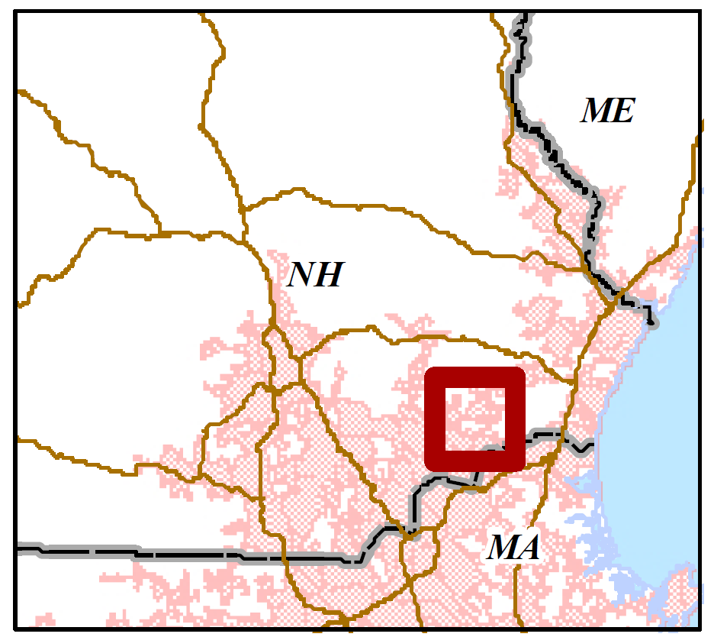
Urbanized Area (UA)
determined by the Bureau of the Census
densely settled core of census tracts with population of at least 50,000
1,000 people per square mile or more.
Urban Areas do not consider municipal boundaries.

Slide 12
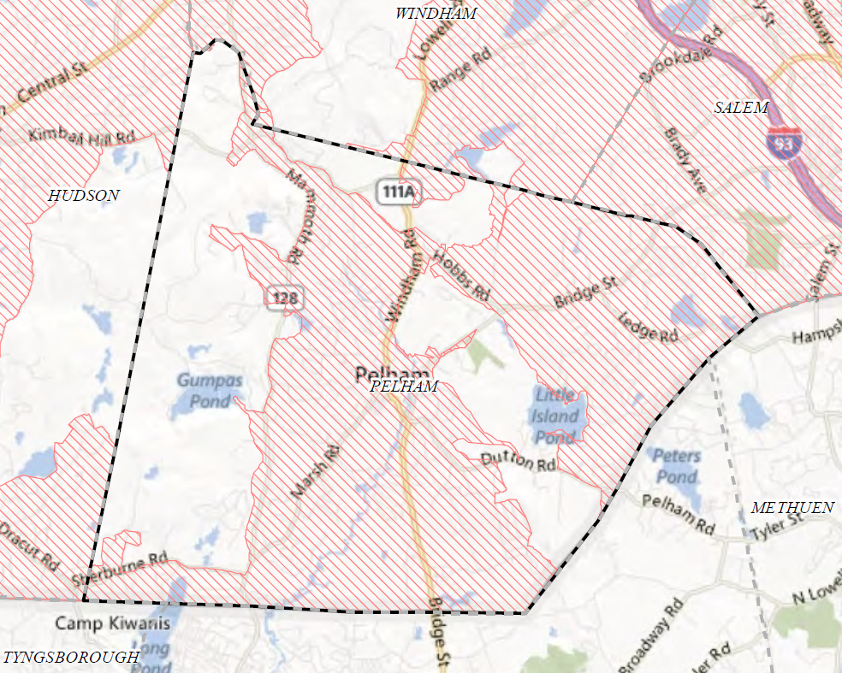
Urbanized Area (UA):
PELHAM NH
https://www3.epa.gov/region1/npdes/stormwater/nh/ram/Pelham.pdf

Slide 13
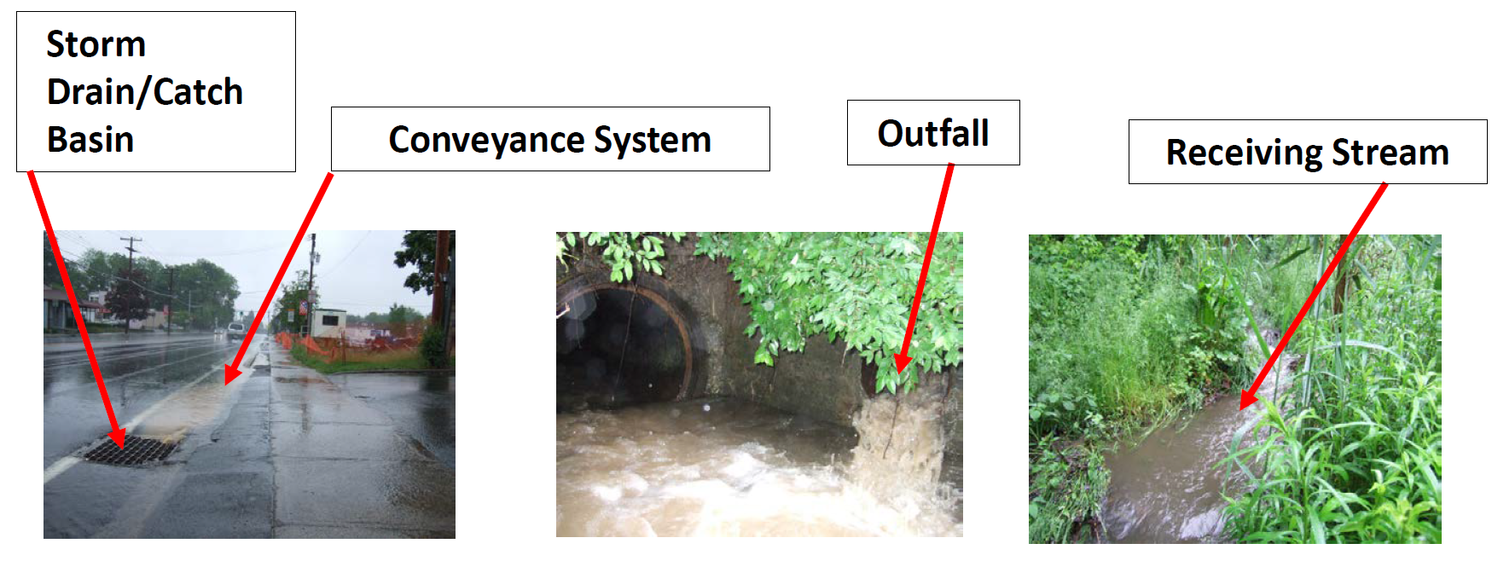
What is MS4 Infrastructure?
Also includes stormwater ponds
MS4 101 Clean Water Act Basics and all those Stormwater Permits. CDRPC Planning and Zoning Workshop, 2019.

Slide 14
What is a BMP?
practices aimed to control non-point source pollution
designed to reduce the pollutants to a waterbody through:
  source reduction by minimizing pollutants available;
  slowing the transport of pollutants by reducing the volume of stormwater; and
  remediating or intercepting the pollutants

Slide 15
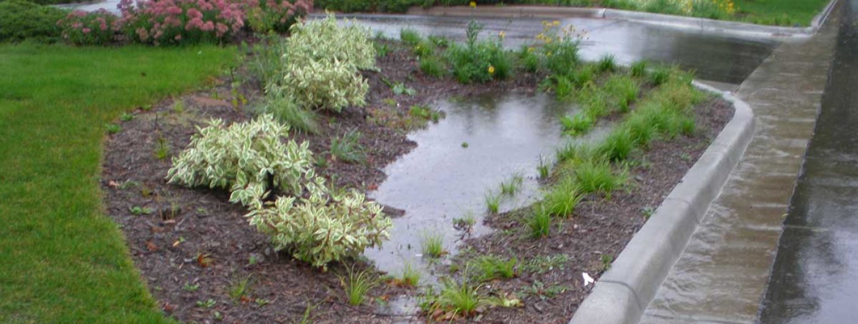
What is a BMP?
Structural BMP
  physical capture and treatment of stormwater
  infiltration practices
  buffer strips
Non-Structural BMPs
  public education
  Low Impact Design
  good housekeeping
  street sweeping
https://extension.umn.edu/landscape-design/rain-gardens

Slide 16

Six Minimum Control Measures (MCMs)
The MS4 Permit requires BMPs for six minimum control measures:
MCM 1 Public Education
MCM 2 Public Participation
MCM 3 Illicit Discharge Detection and Elimination Program
MCM 4 Construction Site Stormwater Runoff Control
MCM 5 Post-Construction Stormwater Management
MCM 6 Good Housekeeping for Municipal Operations

Slide 17

MCM 1 Public Education
Inform the public about the impact of polluted stormwater on water quality.
educate the community on the pollution potential of common activities
increase awareness between land activities and local water resources
give the public specific actions that reduce stormwater pollution
https://americanhistory.si.edu/collections/search/object/nmah_529340

Slide 18

MCM 2 Public Participation
Provide opportunities for the public to be involved in the stormwater management program.
opportunities for direct action and volunteer programs
watershed groups
citizen positions on a local stormwater management committees
https://www.planetizen.com/node/60351

Slide 19
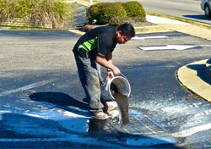
MCM 3 Illicit Discharge Detection
Implement action plans to detect and eliminate illicit discharges to storm sewer systems.
storm sewer system map (asset management program)
ordinance prohibiting illicit discharges
detect and address these illicit discharges
train municipal staff to recognize illicit discharges
http://cwsec-sc.org/what-is-an-illicit-discharge/

Slide 20
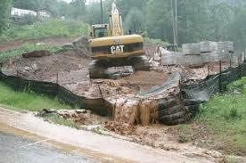
MCM 4 Construction Site Runoff Control
Regulate and enforce erosion and sediment control programs for construction sites.
requirements to implement erosion and sediment control BMPs
regulations and procedures for reviewing construction site plans
procedures for inspections and enforcement of stormwater requirements at construction sites
Understanding MS4. Pennsylvania Environmental Council. January 29, 2016.

Slide 21

MCM 5 Post-Construction Stormwater Management
Implement regulations for new construction and redevelopment post-construction stormwater runoff.
strategies to implement structural and non-structural BMPs
regulations to address post-construction runoff at new development
require as-built plans for stormwater facilities
ensure adequate long-term operation and maintenance

Slide 22
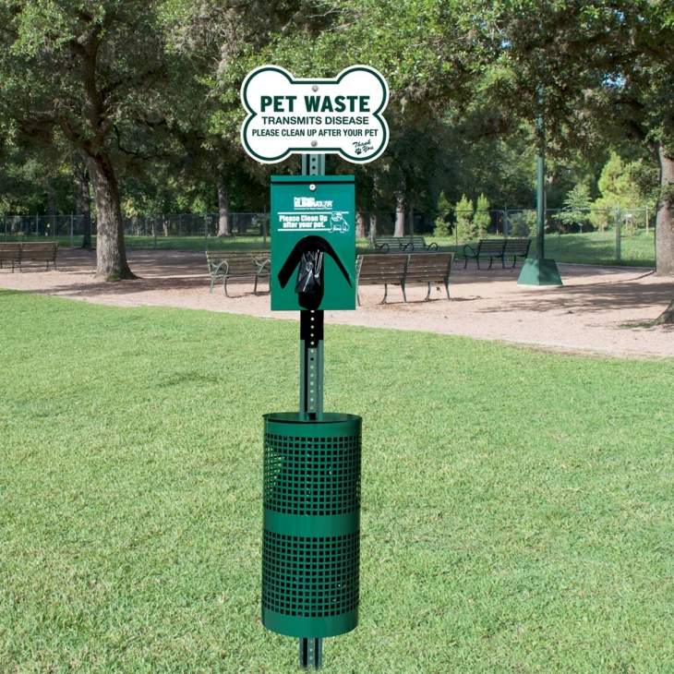
MCM 6 Good Housekeeping
Develop programs to proactively prevent or reduce polluted runoff from municipal operations.
inspection and maintenance procedures
treat pollutants from municipal yards
SWPPPs
properly dispose of pollutants removed
from the MS4 (street sweeping and CB cleaning)
plan mitigation BMPs
https://www.petwasteeliminator.com/e31gre.html

Slide 23
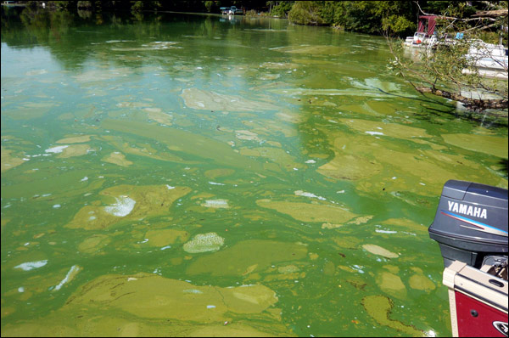
Impaired Waters
NHDES maintains two lists of waters that do not meet water quality standards:
303(d) List – Water Quality Limited Water (WQLW)
305(b) Report - TMDLs
These reports include surface waters that are:
impaired or threatened by a pollutant or pollutant(s)
not expected to meet water quality standards within a reasonable time even after application of standard BMPs
impairments the require implementation of a Total Maximum Daily Load (TMDL) water quality study
https://dailyreporter.com/2010/03/15/officials-propose-new-phosphorus-limits/

Slide 24
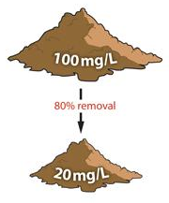
What is a TMDL?
A plan approved by EPA that describes the pollution reductions needed to meet water quality standards.
maximum amount of pollution that a waterbody can receive and still meet water quality standards
municipalities with impaired streams are required to reduce pollution to meet achieve the TMDL standard
http://floridaenet.com/wp-content/uploads/2015/07/2015-CHAMBER-PRESENTATION-V5.compressed1.pdf

Slide 25
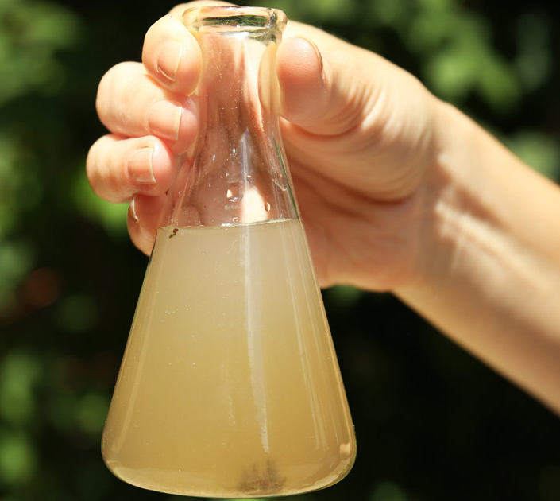
PELHAM MS4 Permit Pollutants of Concern
Bacteria (E. coli)
Statewide TMDLs:
  Long Pond – Town Beach
  Beaver Brook
  Tony’s Brook
Nutrients: Phosphorus (TP) WQLW
    Long Pond
Chloride (none identified in Pelham)
https://www.williamscedar.com/water-contamination-worse-expected/

Slide 26
PELHAM MS4 Permit though Year 4
Annual Updates and Report
Public Education and Participation
Mapping (Asset Management and Analyses)
Outfall Screening and Sampling
Regulation Updates
Internal Procedures
Municipal and Regulation Assessments and Reports
Impaired Water Sampling Plans

Slide 27

EXAMPLE SCHEDULE

Slide 28
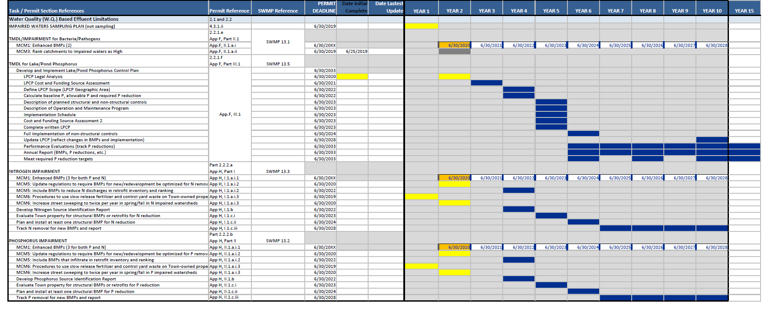
EXAMPLE SCHEDULE

Slide 29

Duty To Comply by Law
2017 NH Small MS4 General Permit - Appendix B.1.
“You must comply with all conditions of this permit. Any permit noncompliance constitutes a violation of the Clean Water Act and is grounds for enforcement action…”
Criminal Penalties – fine and/or imprisonment
  negligent violations $2,500 to $25,000 per day
  knowing violations $5,000 to $50,000 per day
  knowing endangerment up to $250,000 per violation
  false statement up to $10,000 per violation
Civil Penalties up to $32,500 per day
Administrative Penalties up to $11,000 per violation

Slide 30


Slide 31
Plaistow faces $40,000 EPA fine
Eagle Tribune
August 14, 2009
PLAISTOW — A battle is shaping up between town officials and the federal government over a proposed $40,000 fine.
On Wednesday, the Environmental Protection Agency levelled allegations and proposed fines against nine New England communities, including Plaistow, for missing a deadline regarding illegal sewer hookups, according to EPA spokesman Doug Gutro,
The EPA is not saying Plaistow actually has any illegal hookups, Gutro said. The fine is only for failing to show how town officials would detect and remove illegal connections if any did exist.
Other Proposed EPA Fines:
Canton, Mass.: $50,000
Concord, Mass.: $50,000
Dennis, Mass.: $50,000
Eastham, Mass.: $40,000
Gardner, Mass.: $60,000
Peabody, Mass.: $70,000
Winthrop, Mass.: $70,000
Fall River, Mass.: $177,500

Slide 32
NH and PELHAM MS4 Permit Links
NHDES MS4 web page
https://www.des.nh.gov/organization/divisions/water/stormwater/ms4.htm
EPA NH MS4 web page
https://www.epa.gov/npdes-permits/new-hampshire-small-ms4-general-permit
Pelham NH EPA MS4 Map
https://www3.epa.gov/region1/npdes/stormwater/nh/ram/Pelham.pdf
Pelham MS4 SWMP (2019, Year 1)
https://www.pelhamweb.com/sites/g/files/vyhlif4856/f/uploads/9205_pelham_swmp_2019-0827_certified.pdf

Slide 33
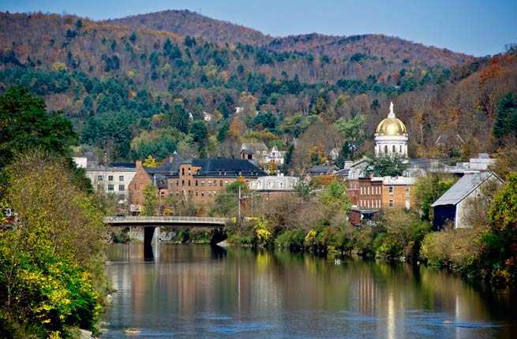
QUESTIONS?

Slide 34
Sources
New Hampshire Department of Environmental Services, Water Division. Municipal Separate Storm Sewer System (MS4) General Permit. https://www.des.nh.gov/organization/divisions/water/stormwater/ms4.htm
Nancy Heinzen, Director Albany County Health Department. MS4 101 Clean Water Act Basics and all those Stormwater Permits. CDRPC Planning and Zoning Workshop, October 23, 2019. https://cdrpc.org/wp-content/uploads/2019/08/MS4101-PPT.pdf
Pennsylvania Environmental Council. Understanding MS4. January 29, 2016. https://pecpa.org/program-update/introductiontostormwaterpermitting/
United States Environmental Protection Agency, Office of Water. Stormwater Phase II Final Rule Fact Sheets. December 2005 through June 2012. https://www.epa.gov/npdes/stormwater-phase-ii-final-rule-fact-sheet-series
New Hampshire Department of Environmental Services. Best Management Practices to Control Nonpoint Source Pollution, A Guide for Citizens and Town Officials. January 2004. https://www.des.nh.gov/organization/commissioner/pip/publications/wd/documents/wd-03-42.pdf
United States Environmental Protection Agency. New Hampshire Small MS4 General Permit. January 18, 2017. https://www.epa.gov/npdes-permits/new-hampshire-small-ms4-general-permit#2017fp
Martin R. Siegel, Stock and Leader. EPA fines Municipalities for MS4 Stormwater Violations. May 22, 2017. https://www.stockandleader.com/government-law/epa-fines-municipalities-ms4-stormwater-violations
Patrick lester, The morning call. Pennsylvania municipalities targeted in clean water crackdown. April 25, 2015. https://www.mcall.com/news/local/mc-lehigh-valley-epa-storm-water-crackdown-20150425-story.html
Margo Sullivan, Eagle Tribune. Plaistow faces $40,000 EPA fine. Aug 14, 2009. https://www.eagletribune.com/news/local_news/plaistow-faces-epa-fine/article_731affbe-b05e-54ad-9735-74e40ac5a4b2.html

